Slide 1
Olympic Athletes and Age
Ryan Connors | Ojas Mhetar | Allan Chua | Omar Malik

Slide 2
Executive Summary
We began this project by examining a data set on the Olympic Games since the 2000 games in Sydney Australia.
We set out to determine if we could predict, given the data we have available on Olympic athletes, whether the athlete is younger or older than the mean age.
Our goal is to develop an accurate predictability model to classify the athlete as either “Young”: at or younger than the mean age, or “Old” older than the mean age of Olympic athletes.
Notes:
Omar

Slide 3
Data and Data Sources
Data of winning Olympic athletes in the Olympic Games since 2000
10 Variables: Athlete, Age, Country, Year, Closing_Date, Sport, Gold, Silver, Bronze, Total, NewAge, New Athlete
Source: www.tableausoftware.com/public/community/sample-data-sets
Notes:
Ojas

Slide 4
Data and Data Sources
Name | Type | Description
Athlete | String | the athletes name
Age | Integer | age of the athlete (in years)
Country | String | athletes home country
Year | Integer | current year of this occurrence
Closing.Ceremony.Date | Integer (1904)* | the date of the closing ceremony of the games in this occurrence
Sport | String | sport the athlete is competing in
Name | Type | Description
Bronze.Medals | Integer | number of bronze medals won by the athlete in this occurrence
Silver.Medals | Integer | number of silver medals won by the athlete in this occurrence
Gold.Medals | Integer | number of gold medals won by the athlete in this occurrence
Total.Medals | Excel Formula** | total number of medals won by the athlete in this occurrence
* The closing ceremony date is stored as an integer representing the number of elapsed days since january 1st 1904. For example July 5th 1998 would be 34519.
** The total medals are represented in the data set by an Excel formula, summing each medal count in each row (occurrence)
Notes:
Ojas

Slide 5
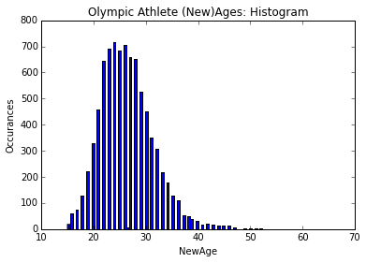
Data Interpretation
Numerical Summaries
Bronze Medals:
mean : 0.38
standard deviation of 0.51
75% of the occurrences have only 1 bronze medal
there is at least one occurrence of 3 bronze medals
Silver Medals:
mean : 0.36
standard deviation of 0.51
75% of the occurrences have only 1 silver medal
there is at least one occurrence of 3 silver medals
Gold Medals:
mean : 0.36
standard deviation of 0.54
75% of the occurrences have only 1 gold medal
there is at least one occurrence of 8 gold medals
Age:
mean of 26.4
standard deviation of 5.10
min:15 -> 25%:[23] -> 50%[26] -> 75%[29] -> max:61
Notes:
Ojas

Slide 6
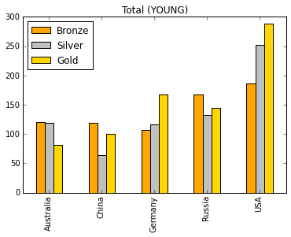
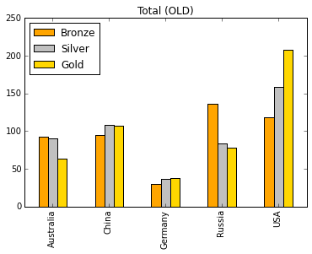
Visualizations & Discussion
Notable differences:
Younger athletes from China have many fewer silver, and more bronze, than older athletes
Older athletes from Germany have many fewer overall medals than younger athletes
Older Russian athletes have many fewer silver and gold medals than younger athletes
Notes:
Ryan

Slide 7
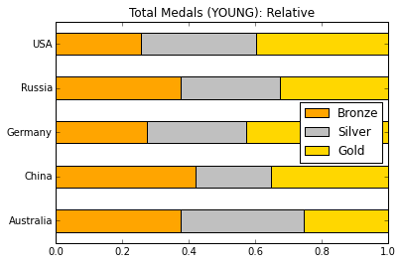
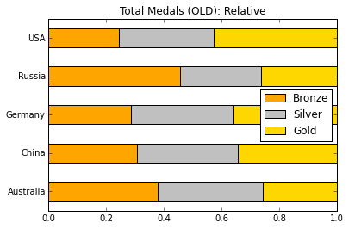
Visualizations & Discussion
We see the biggest differences with China:
young athletes: a larger portion have won bronze medals, and less silver.
older athletes: less bronze and more silver medals
gold medals remain relatively constant between old and young athletes
Notes:
Ryan

Slide 8
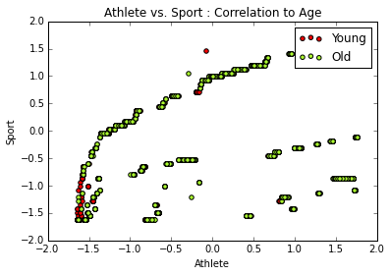
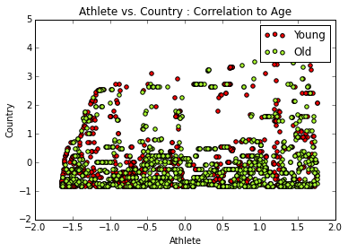
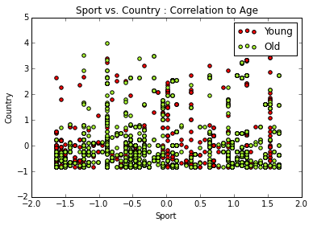
Visualizations & Discussion
Visualizing a potential correlation between the different variables and the age of the athlete
Plotting the categorical variables against each other using scatterplots we cannot see any clear distinction between the “Young” and “Old” athletes
Notes:
Ryan

Slide 9
Machine Learning Algorithm
Stochastic Gradient Descent (SGD) Machine Learning Algorithm
SGD Coefficients
Intercept | (-0.69)
Athlete | (-0.52)
Country | 0.53
Year | 0.84
Sport | 1.26
Bronze | 0.37
Silver | 0.96
Gold | (-0.20)
Total | 1.37
We see that the Athlete and Gold variables have a negative impact on the model.
The Sport variable has the largest impact on the SGD learning algorithm, followed by the number of Silver medals.
This suggests that the sport the athlete is competing in has the most effect on predicting whether or not any given athlete is younger or older than the mean age.
Notes:
Ojas

Slide 10
Machine Learning Algorithm
Gaussian Naive-Bayes : 54% accuracy
SVM Classification : 59% Accuracy
 | precision | recall | f1-score | support
False | 0.64 | 0.36 | 0.46 | 3544
True | 0.49 | 0.76 | 0.60 | 2919
avg/total | 0.57 | 0.54 | 0.52 | 6463
 | precision | recall | f1-score | support
False | 0.60 | 0.78 | 0.68 | 3544
True | 0.58 | 0.37 | 0.45 | 2919
avg/total | 0.59 | 0.59 | 0.57 | 6463
K Nearest Neighbor : 55% accuracy
 | precision | recall | f1-score | support
False | 0.55 | 0.99 | 0.71 | 3544
True | 0.53 | 0.01 | 0.03 | 2919
avg/total | 0.54 | 0.55 | 0.40 | 6463
We see that most of the Machine Learning Algorithms cannot perform much better than 50%
Our best performing algorithm was the SVM Classification algorithm with 59% accuracy
Notes:
Allan

Slide 11
ML Results
SVM(Support Vector Machine) Classification Algorithm
SVM Confusion Matrix
Anticipated results:
True Positives : 2769
False Negatives : 1070
total: 3,839
Unanticipated results:
True Negatives : 1849
False Positives : 775
total: 2,624
 | True | False
Positive | 2769 | 775
Negative | 1849 | 1070
We see from the confusion matrix that we have 59% anticipated results (True Positives and False Negatives) from the SVM classification algorithm
Supervised learning model that maps the data in 2D space, determines a gap dividing the two groups and new data is predicted to belong to the category on either side of the gap
Notes:
Ryan

Slide 12
Conclusions
Certain characteristics were better predictors of the athletes age, such as the sport and the total medals.
Model could be more effective if there was data on athletes who competed but did not win.
You could use this data to determine sports where older athletes would outperform younger athletes
Notes:
Allan

